Slide 1
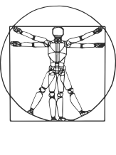
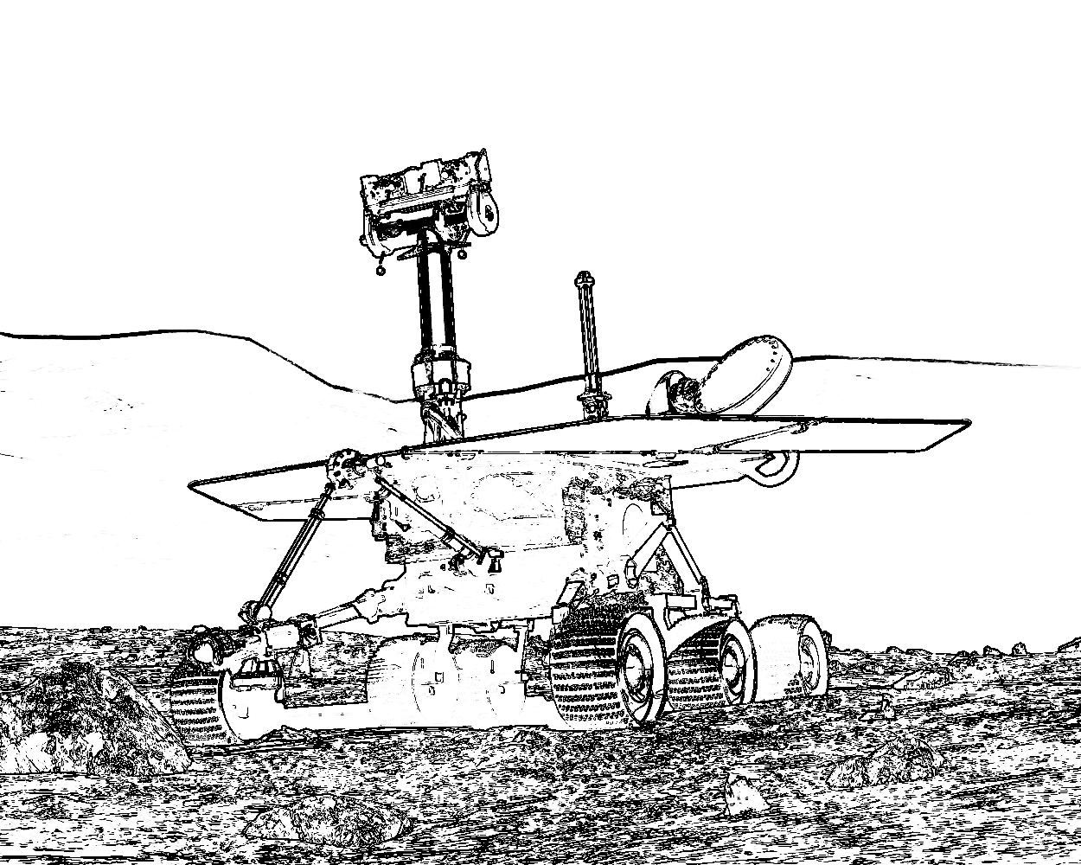


COMP417 Introduction to Robotics and Intelligent Systems Lecture 19: Applying the EKF on Examples Visual SLAM
David Meger
Nov 26, 2019

Slide 2
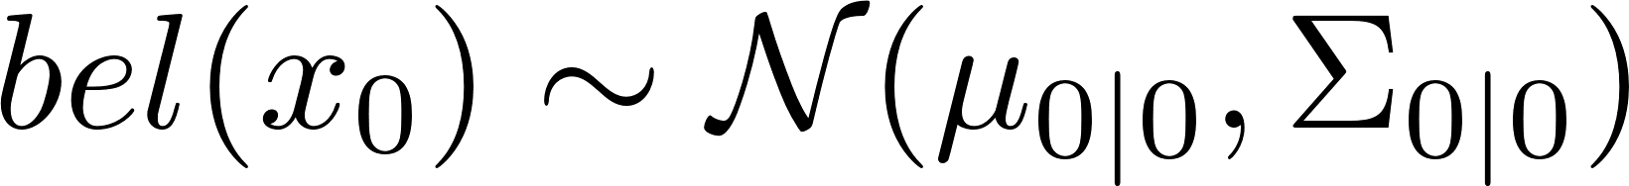

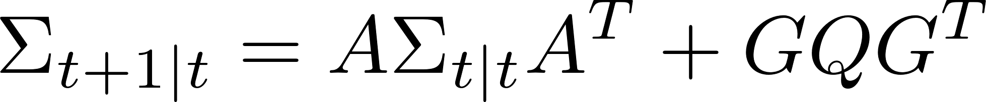
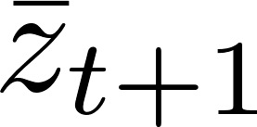
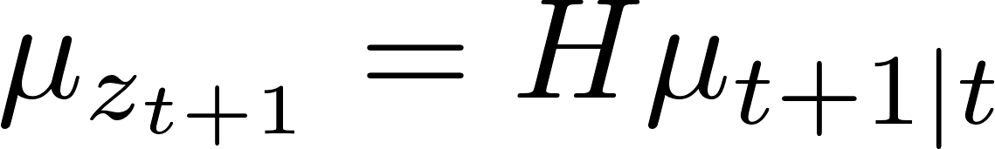

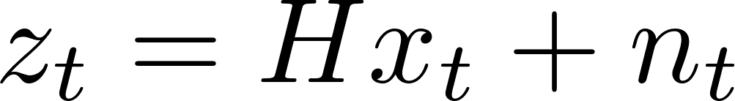
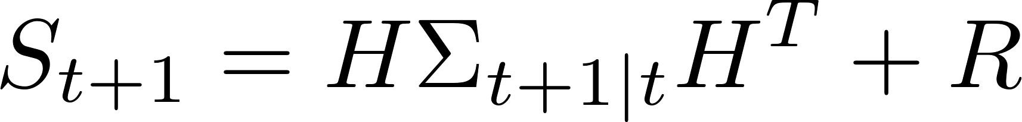
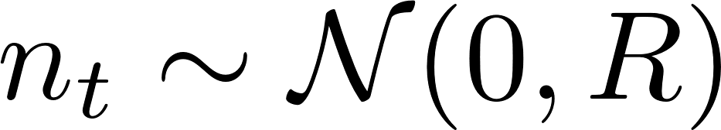
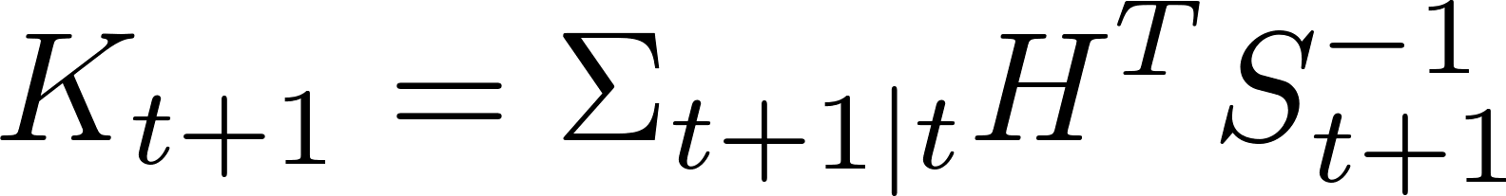
KF vs EKF
Initial Gaussian Belief
Prediction Step
Linear Motion
w/Gaussian Noise
Update Step
Received measurement but expected
Linear Measurement
w/Gaussian Noise
Prediction residual is a Gaussian
random variable
with covariance:
Kalman Gain (optimal correction factor):
We update the
mean and covariance by:

Slide 3
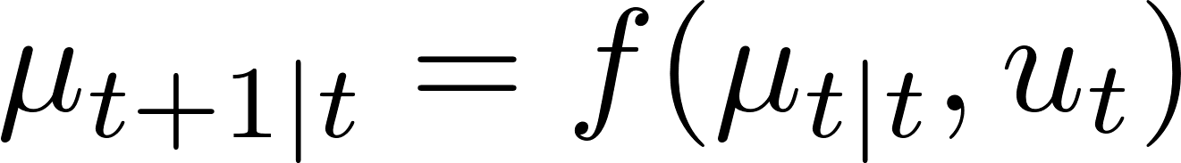
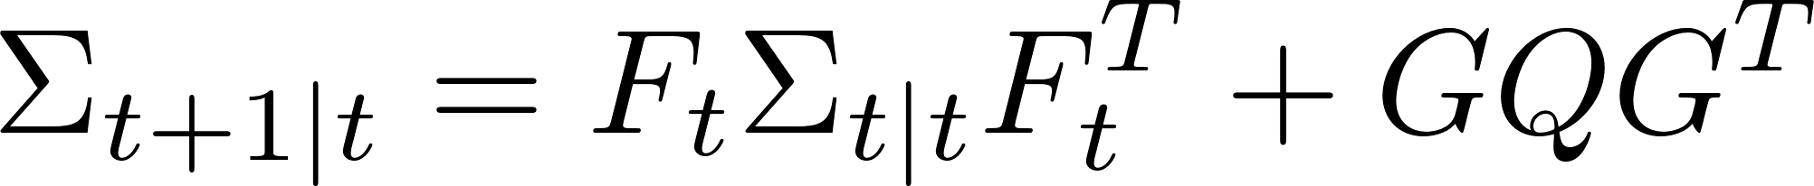
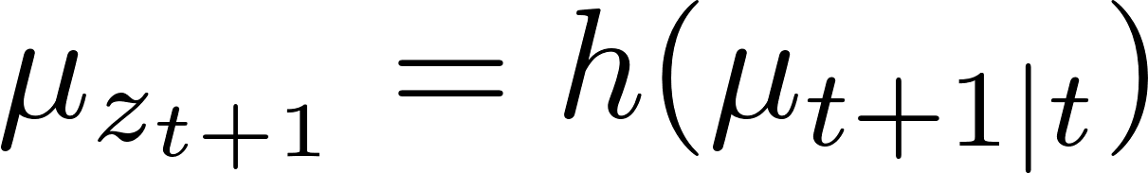
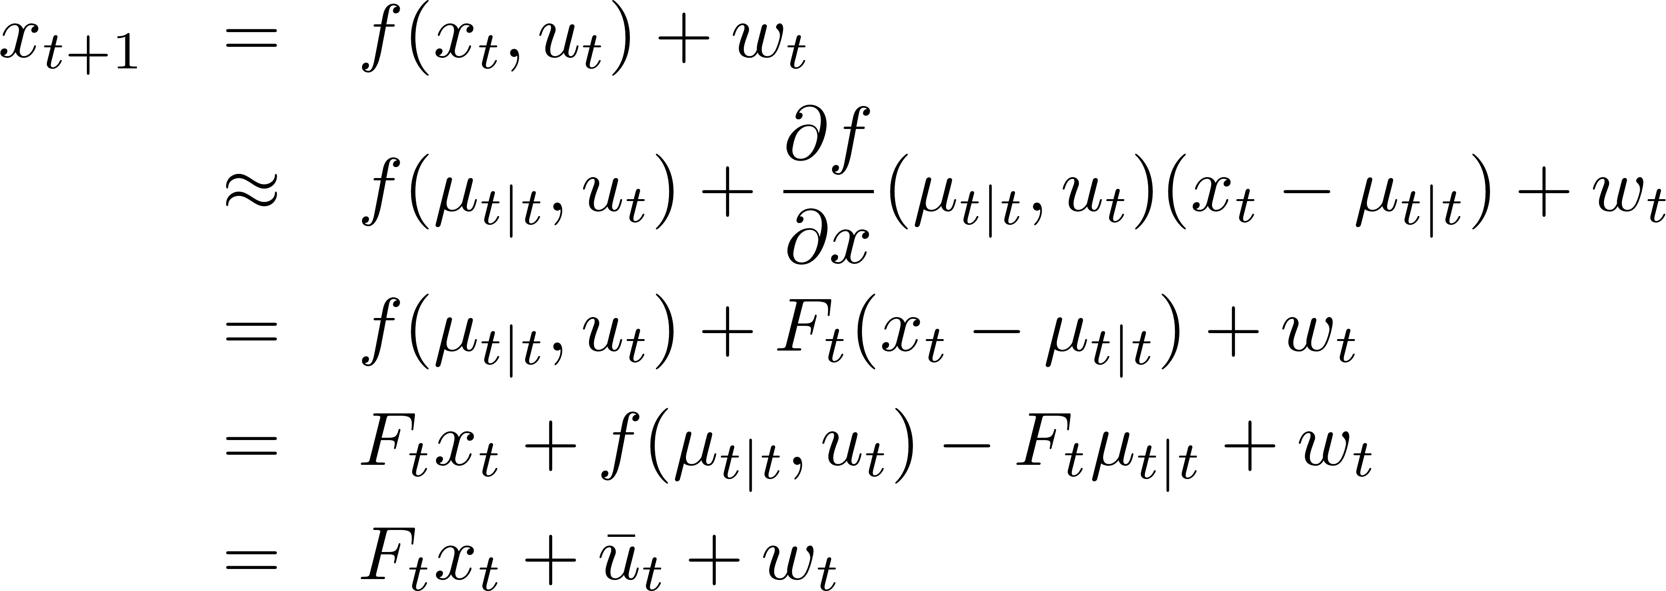
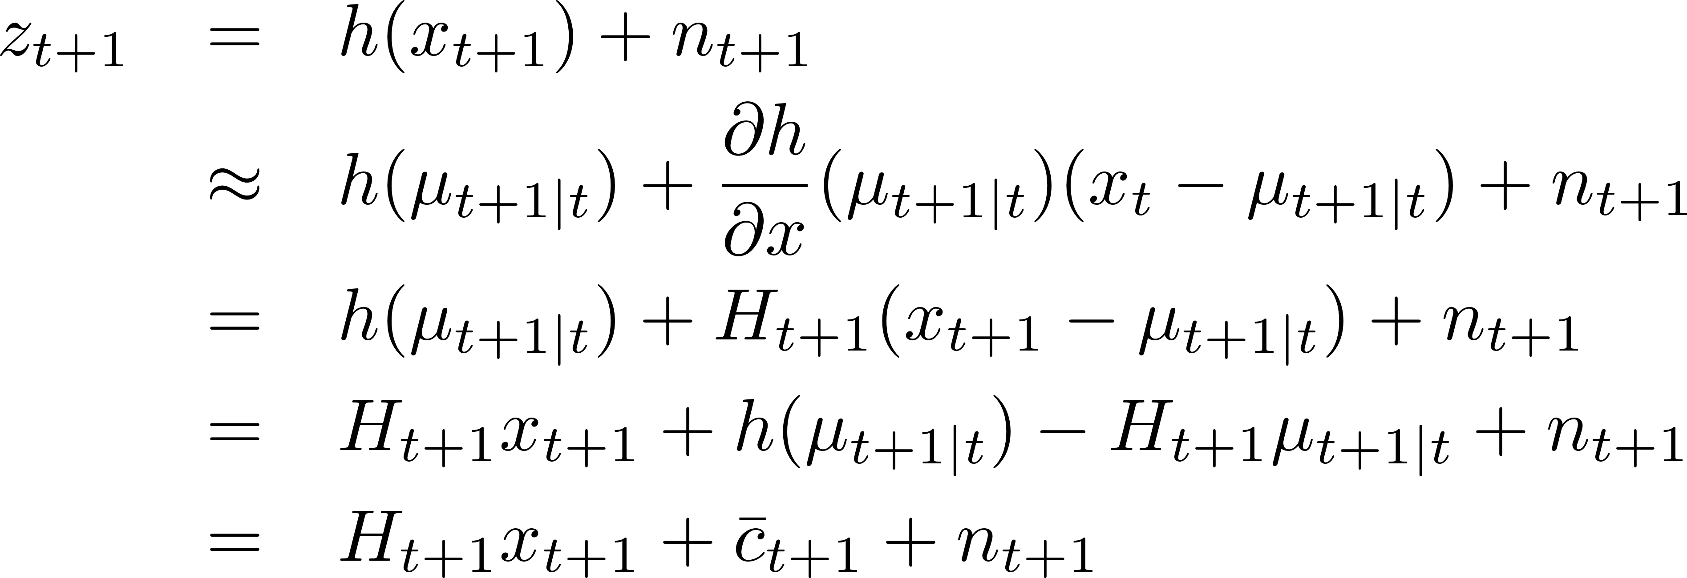
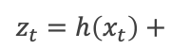
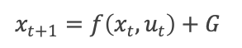
KF vs EKF
Initial Gaussian Belief
Prediction Step
Non-linear Motion
w/Gaussian Noise
Update Step
$x_{t+1}=f\left(x_{t},u_{t}\right)+G$
Received measurement but expected
Non-linear Measurement
w/Gaussian Noise
Prediction residual is a Gaussian
random variable
with covariance:
$z_{t}=h\left(x_{t}\right)+$
Linearize:
Kalman Gain (optimal correction factor):
We update the
mean and covariance by:

Slide 4
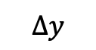
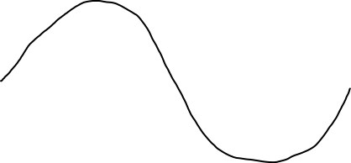
Recall: Linearization in 1D
The red line approximates the non-linear curve near x=a
Here df/dx = cos(x), still a function of x
To get the constant slope of the red line, we substitute x with its value at the approximation point, a:
The line shown has slope cos(a)
Approximated y value is f(a)+cos(a)*(x-a). This equals f(a) at a, and is “near” sin(x) around a
Far from a, this is a terrible approximation, so we want to recompute often
All other points:
(x,f(a)+df/dx(a)*(x-a))
Contact point:(a,f(a))
$$∆y$$
(x-a)
y=sin(x)

Slide 5
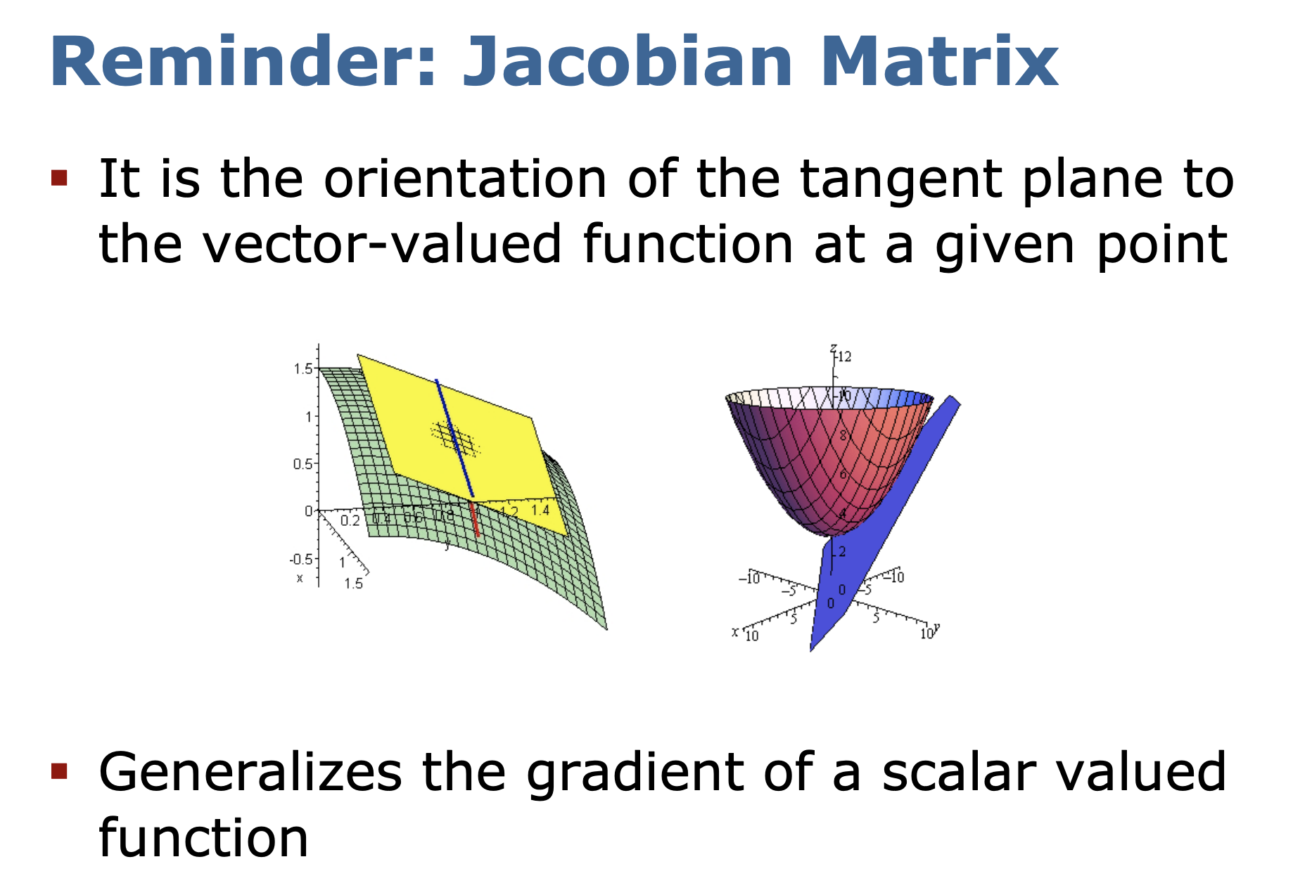

Slide 6
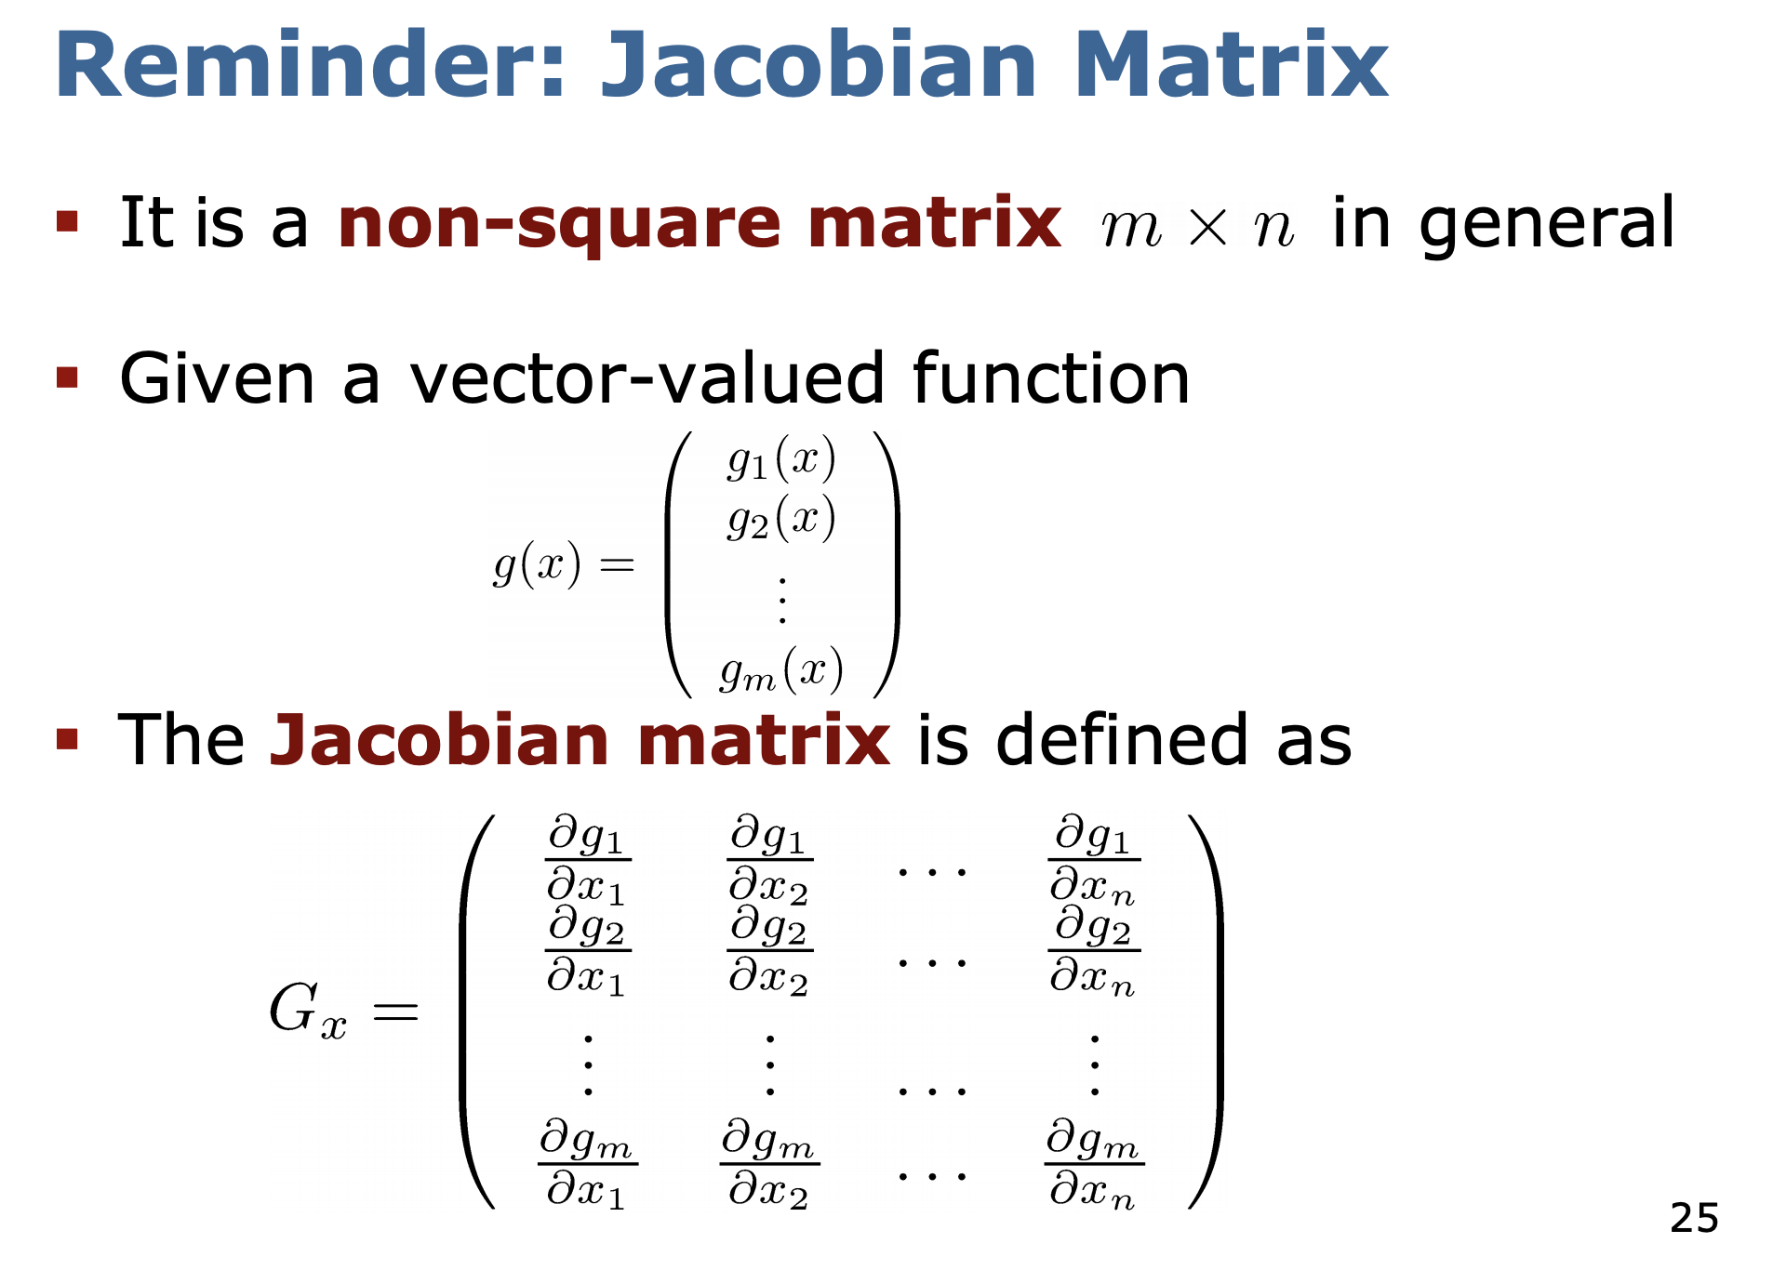
Number of rows equals the number of vector components in g(x).
Number of columns equals the number of ”w.r.t.” dimensions.

Slide 7
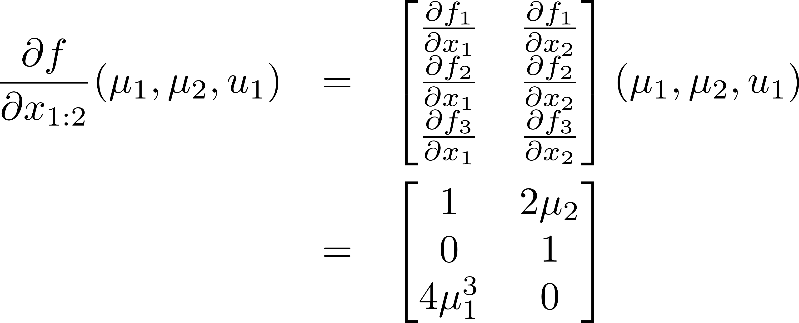
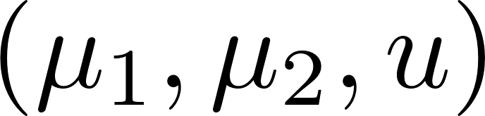
Computing the Jacobian
Write f as a vector function:
Apply the gradient definition:
Partials of each component of f
This can still be a function of x and u:
= 1
= 2x etc..
To get a constant slope substitute
The value of the approximation point:
Note in this example we have no “u” in the result. In general it can appear here, such as if an entry in f is x1*u.

Slide 8
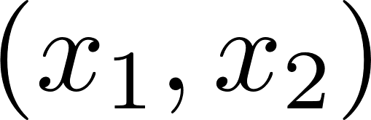
How do we linearize for the EKF?
Using the first order Taylor expansion around the mean of the previous update step’s state estimate:
Recall how to compute the Jacobian
matrix. For example, if
then the Jacobian of f with respect to
at is
Constant term
with respect to
the state

Slide 9
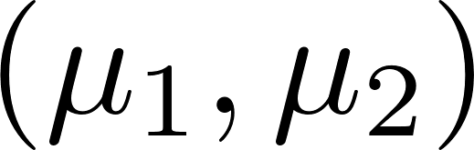
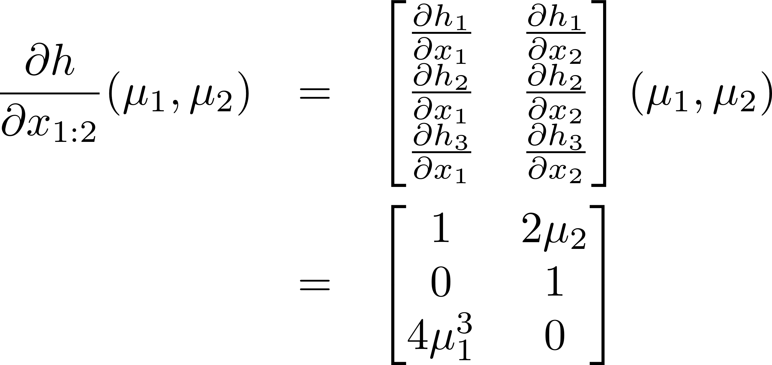
How do we linearize for the EKF?
Using the first-order Taylor expansion around the mean of the previous prediction step’s state estimate:
Recall how to compute the Jacobian
matrix. For example, if
then the Jacobian of f with respect to
at is
Constant term
with respect to
the state

Slide 10

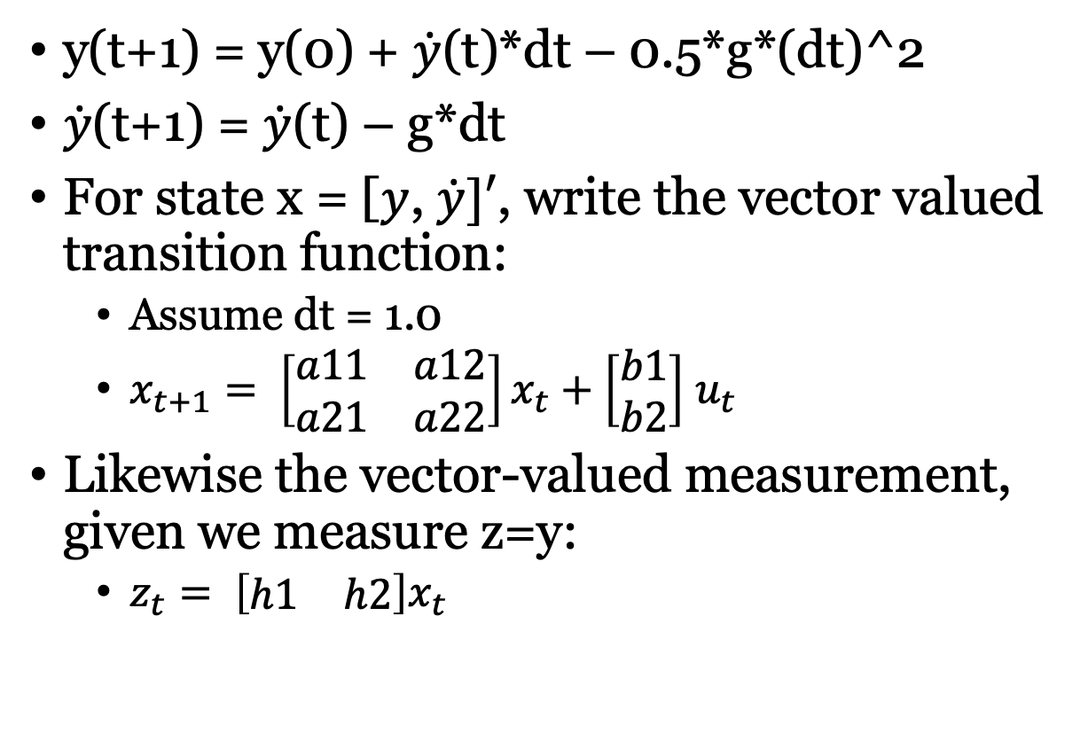
Example 1: Linear Motion
y(t+1) = y(0) + $\dot{y}$(t)*dt – 0.5*g*(dt)^2
$\dot{y}$(t+1) = $\dot{y}$(t) – g*dt
For state x = [$y$, $\dot{y}]′$, write the vector valued transition function:
Assume dt = 1.0
$x_{t+1}= \left[\begin{matrix}a11 & a12 \\ a21 & a22\end{matrix}\right]x_{t}+\left[\begin{matrix}b1 \\ b2\end{matrix}\right]$ $u_{t}$
Likewise the vector-valued measurement, given we measure z=y:
$z_{t}= \left[\begin{matrix}h1 & h2\end{matrix}\right]x_{t}$
Velocity: $\dot{y}$
Force: g
Height: y

Slide 11

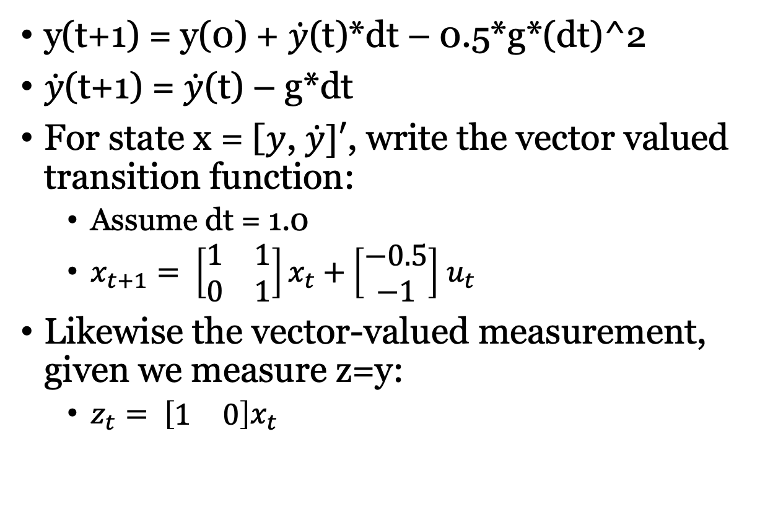
Example 1: Linear Motion
y(t+1) = y(0) + $\dot{y}$(t)*dt – 0.5*g*(dt)^2
$\dot{y}$(t+1) = $\dot{y}$(t) – g*dt
For state x = [$y$, $\dot{y}]′$, write the vector valued transition function:
Assume dt = 1.0
$x_{t+1}= \left[\begin{matrix}1 & 1 \\ 0 & 1\end{matrix}\right]x_{t}+\left[\begin{matrix}−0.5 \\ −1\end{matrix}\right]$ $u_{t}$
Likewise the vector-valued measurement, given we measure z=y:
$z_{t}= \left[\begin{matrix}1 & 0\end{matrix}\right]x_{t}$
Velocity: $\dot{y}$
Force: g
Height: y
NOTE: This is already linear, no need for EKF.

Slide 12

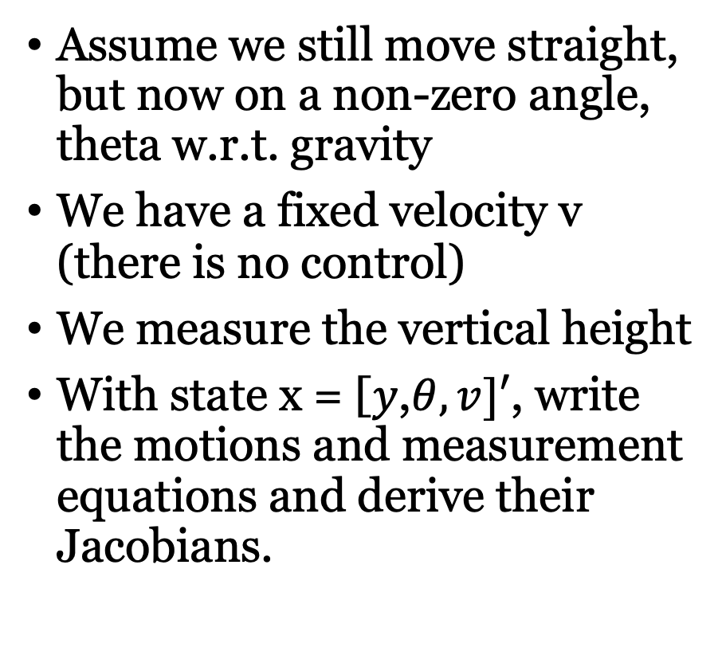

Example 2: Diagonal Motion
Assume we still move straight, but now on a non-zero angle, theta w.r.t. gravity
We have a fixed velocity v (there is no control)
We measure the vertical height
With state x = [$y$,$θ,v]′$, write the motions and measurement equations and derive their Jacobians.
Velocity: $v$
$$θ$$
Height: y

Slide 13

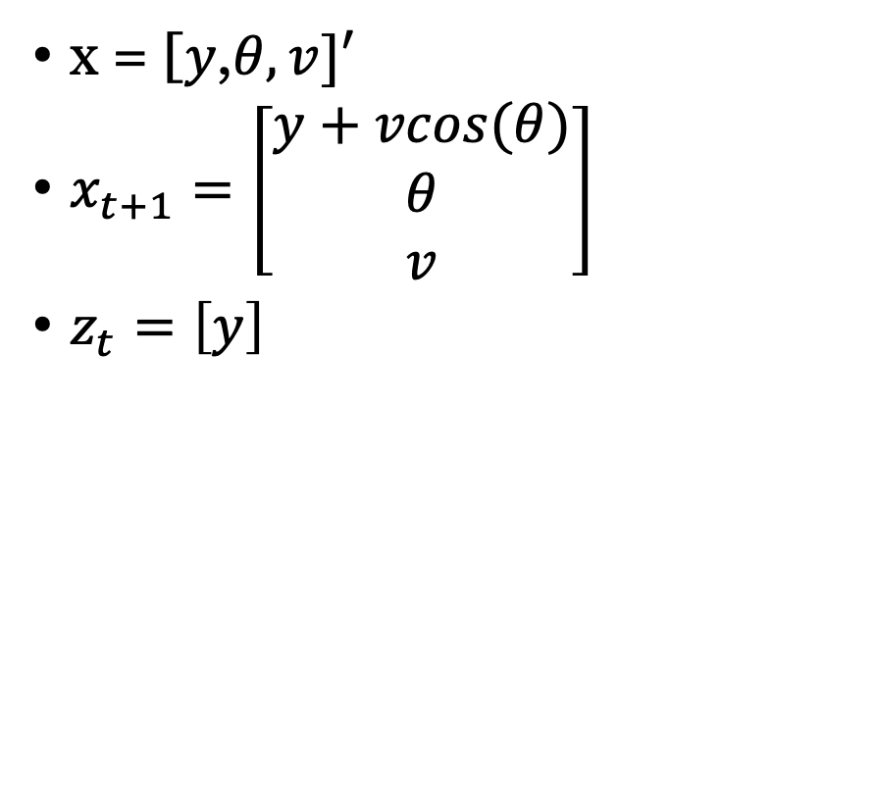

Example 2: Diagonal Motion
x = [$y$,$θ,v]′$
$x_{t+1}=\left[\begin{matrix}y+vcos(θ) \\ θ \\ v\end{matrix}\right]$
$z_{t}=\left[y\right]$
Velocity: $v$
$$θ$$
Height: y

Slide 14

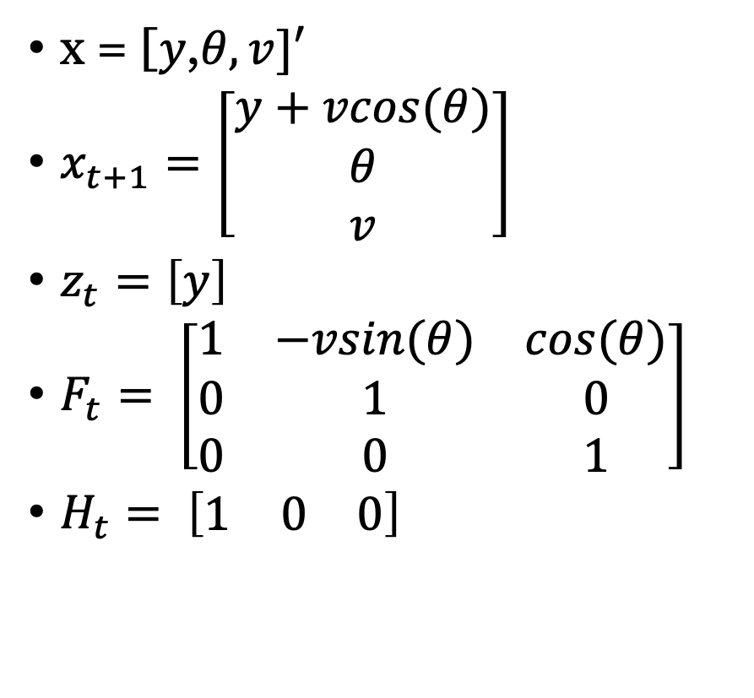

Example 2: Diagonal Motion
x = [$y$,$θ,v]′$
$x_{t+1}=\left[\begin{matrix}y+vcos(θ) \\ θ \\ v\end{matrix}\right]$
$z_{t}=\left[y\right]$
$F_{t}= \left[\begin{matrix}1 & −vsin(θ) & cos(θ) \\ 0 & 1 & 0 \\ 0 & 0 & 1\end{matrix}\right]$
$H_{t}= \left[\begin{matrix}1 & 0 & 0\end{matrix}\right]$
Velocity: $v$
$$θ$$
Height: y

Slide 15
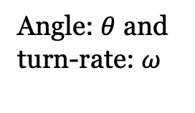

Example 3: Dubin’s
State is x,y,theta.
Measurement is squared distance to a landmark, l
Write the motion and measurement equations and take their Jacobians.
Distance^2: z
Centre: (x,y)
Velocity: $v$
Angle: $θ$ and
turn-rate: $ω$

Slide 16

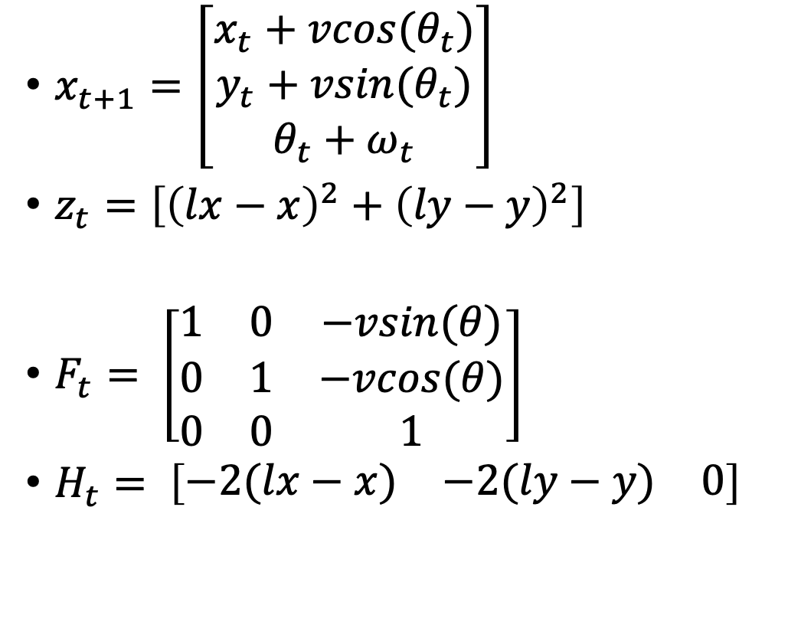
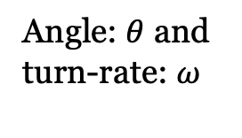
Example 3: Dubin’s
$x_{t+1}=\left[\begin{matrix}x_{t}+vcos(θ_{t}) \\ y_{t}+vsin(θ_{t}) \\ θ_{t}+ω_{t}\end{matrix}\right]$
$z_{t}=\left[{\left(lx−x\right)}^{2}+{\left(ly−y\right)}^{2}\right]$
$F_{t}= \left[\begin{matrix}1 & 0 & −vsin(θ) \\ 0 & 1 & −vcos(θ) \\ 0 & 0 & 1\end{matrix}\right]$
$H_{t}= \left[\begin{matrix}−2(lx−x) & −2(ly−y) & 0\end{matrix}\right]$
Distance^2: z
Centre: (x,y)
Velocity: $v$
Angle: $θ$ and
turn-rate: $ω$

Slide 17
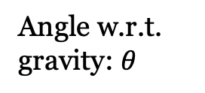
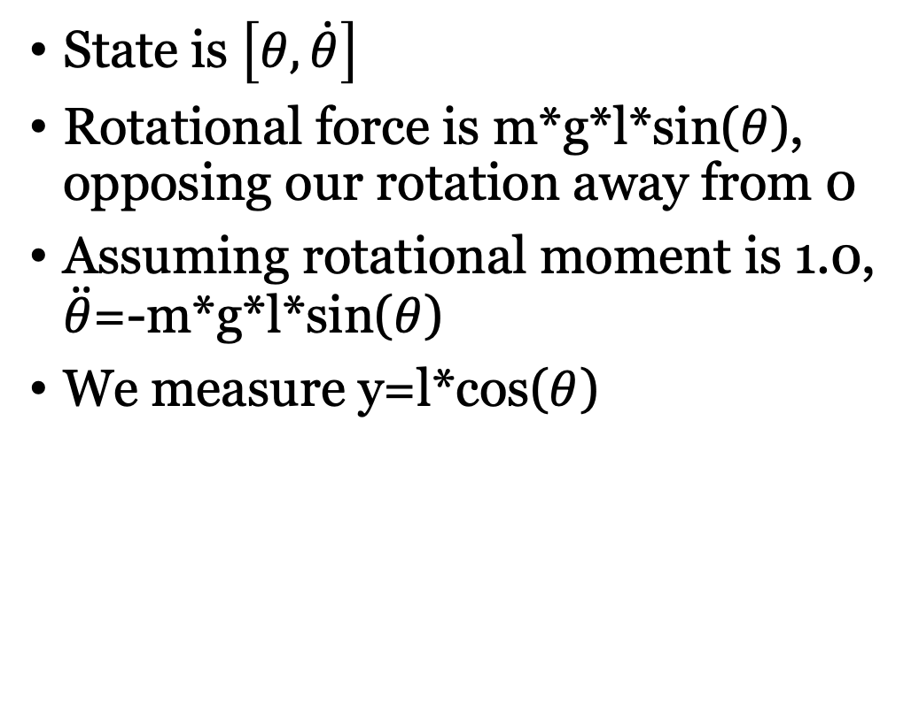
Example 4: Pendulum
State is $\left[θ, \dot{θ}\right]$
Rotational force is m*g*l*sin($θ$), opposing our rotation away from 0
Assuming rotational moment is 1.0, $\ddot{θ}$=-m*g*l*sin($θ$)
We measure y=l*cos($θ$)
Anchor point at (0,0)
Angle w.r.t.
gravity: $θ$
Height: y
Pole
length: l
Centre: (x,y)
Force downwards: g

Slide 18
Part 2: Visual Navigation for Robots
I’ll describe one of the best visual navigation packages called ORBSLAM 2.0. More info can be found here: https://webdiis.unizar.es/~raulmur/orbslam/
You can download and try this code (it’s not so hard compared to installing ROS)…
The paper’s PDF is expected to be above COMP 417 level, but you would be able to understand many elements, and it’s a good source to dig into for learning and future research projects
Many fun videos on really challenging video sequences

Slide 19
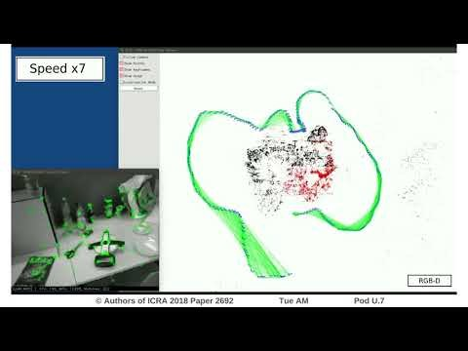

Slide 20
ORB-SLAM
One of the most popular current visual mapping systems
The first open source tool that "really works" (this is a sketchy comment)
3D maps of points and camera trajectories are constructed based on matching "Oriented FAST and Rotated BRIEF" visual features
Several layers of processing:
Local feature tracking
Localizing keyframes
Loop closure
Back-end involves sparse bundle adjustment

Slide 21
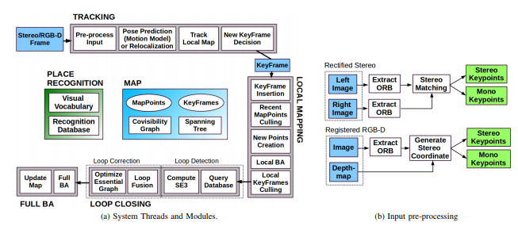
The overview: A beautiful mess!

Slide 22
Big Picture
Fast(ish) feature-based image processing lets us relate current image to map with minimal compute
A bit slower local mapping "adjusts" (through BA) how the local features and cameras fit with the keyframe. Still fairly fast because only a few features are considered.
Very occassional loop closure is the hardest optimization attempted. It uses co-visibility to optimize an essential graph, which is lighter than the full camera-to-camera graph, which we never touch.

Slide 23
First step, compute and match features

Slide 24
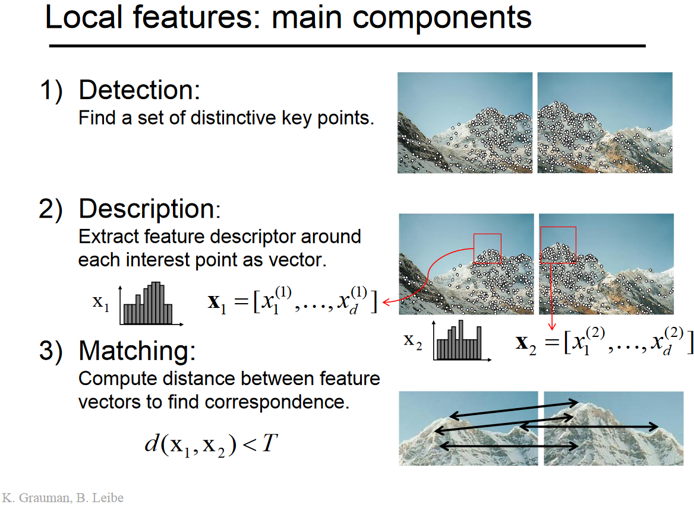

Slide 25
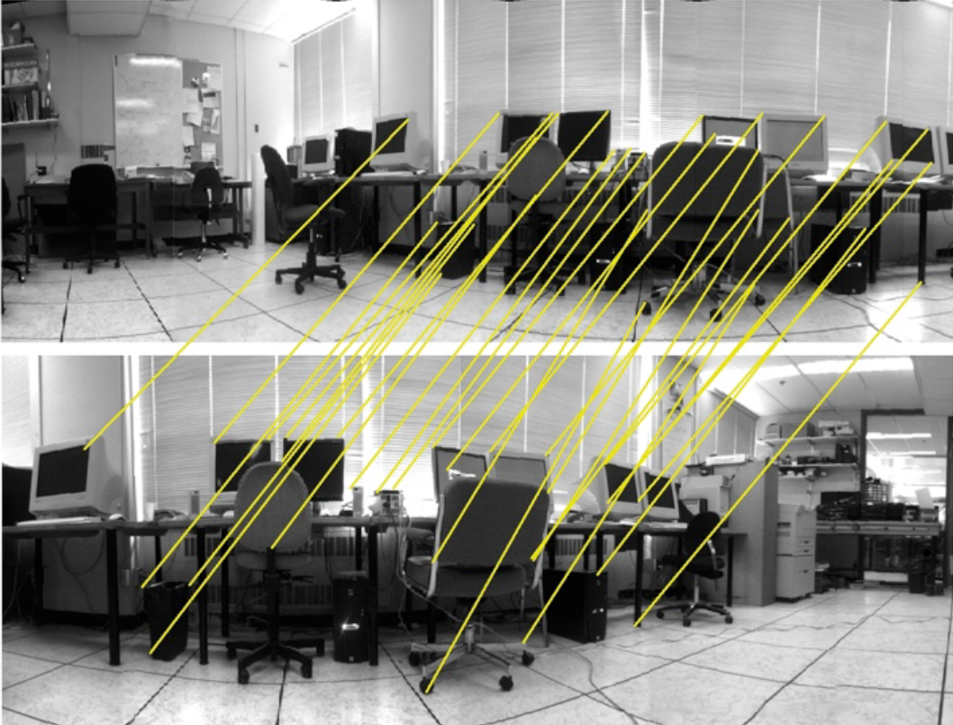
Feature matching

Slide 26
Why ORB Features?
These are fast to compute and reliable compared with alternatives (that were available at the time)
Binary texture descriptor BRIEF: Binary Robust Independent Elementary Features is stored as a bit-string. Comparison can be done very rapidly using bit-wise operations
Key concept: Images are big, it's too costly to store and search all of the pictures we'd take of a city. ORBs effectively compress these and allow fast lookups.

Slide 27
Next, find local pose

Slide 28
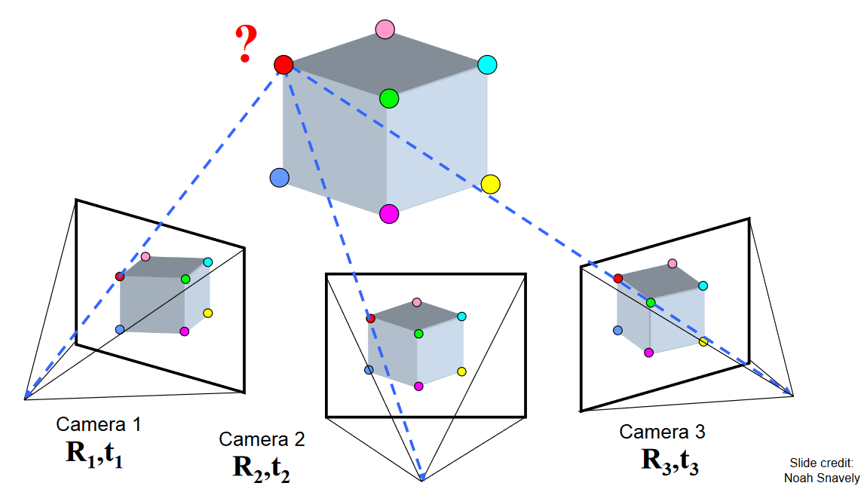
Quick background: Visual geometry
Images of the same 3D point project to different 2D image space locations, under camera’s geometry (we assume known)
With sufficient correct matches (e.g. all corners on the cube), we can solve for:
All 3D point locations
R and t of each camera
All in the same frame
BUT with a scale ambiguity

Slide 29
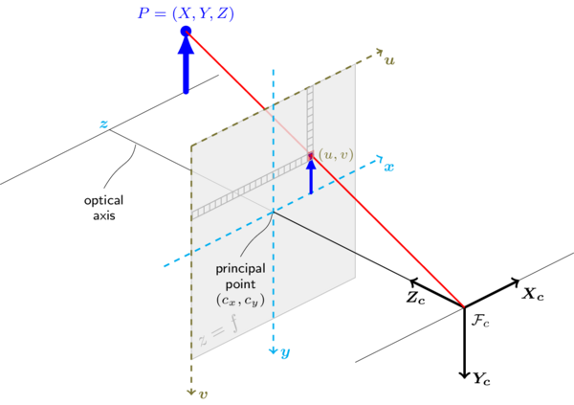
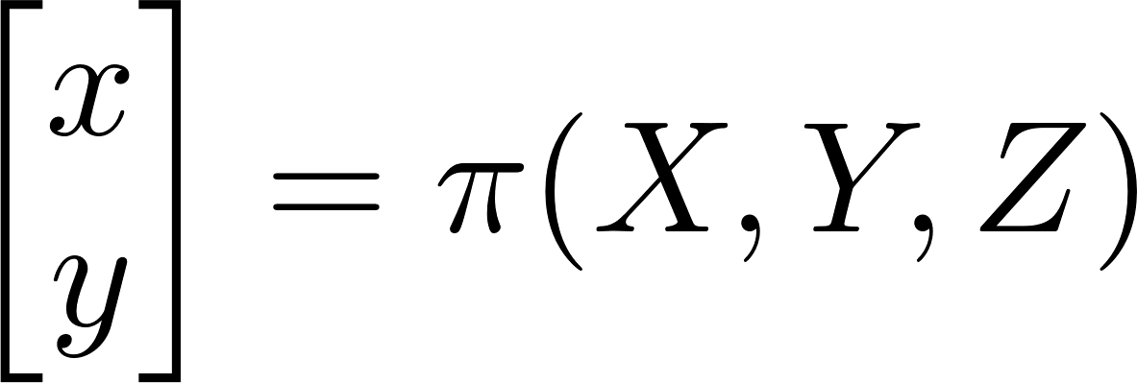
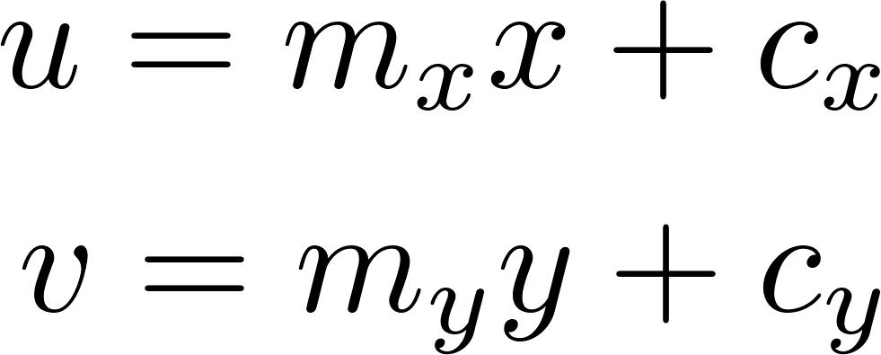

From 3D points to pixels: pinhole camera
(1) Perspective projection
(2) Conversion from metric to pixel coordinates
z=f
represent number of pixels per mm for the two axes

Slide 30
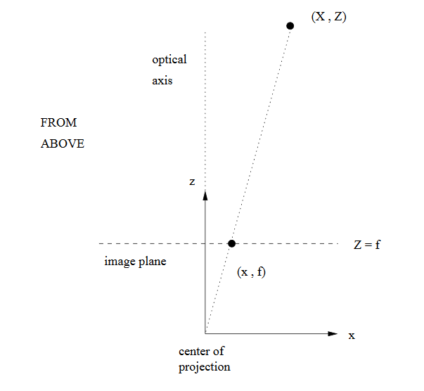

Perspective projection [x,y] = $π$(X,Y,Z)
By similar triangles: x/f = X/Z
So, x = f * X/Z and similarly y = f * Y/Z
Problem: we just lost depth (Z) information by doing this projection, i.e. depth is now uncertain.
http://www.cim.mcgill.ca/%7Elanger/558.html

Slide 31
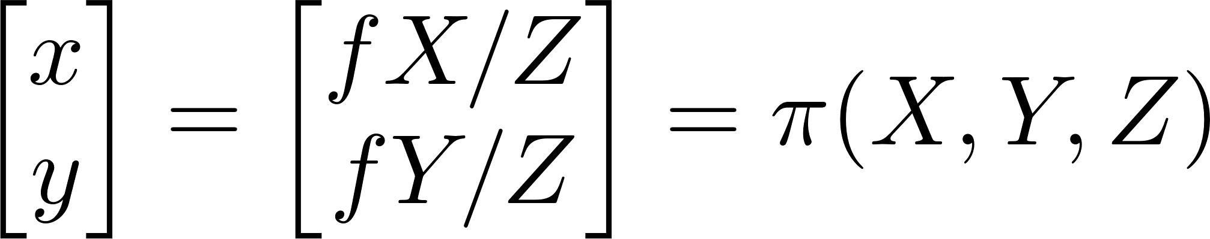

From 3D points to pixels: pinhole camera
(1) Perspective projection
(2) Conversion from metric to pixel coordinates
z=f

Slide 32
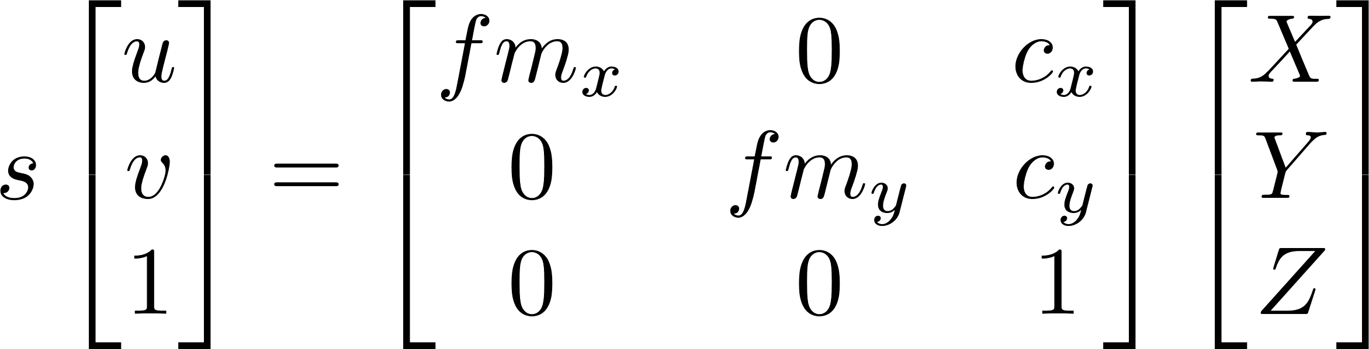
Background: From 3D points to pixels: pinhole camera
(1) Perspective projection
(2) Conversion from metric to pixel coordinates
Unknown depth/scale
Camera calibration matrix
z=f
Usually presented as

Slide 33
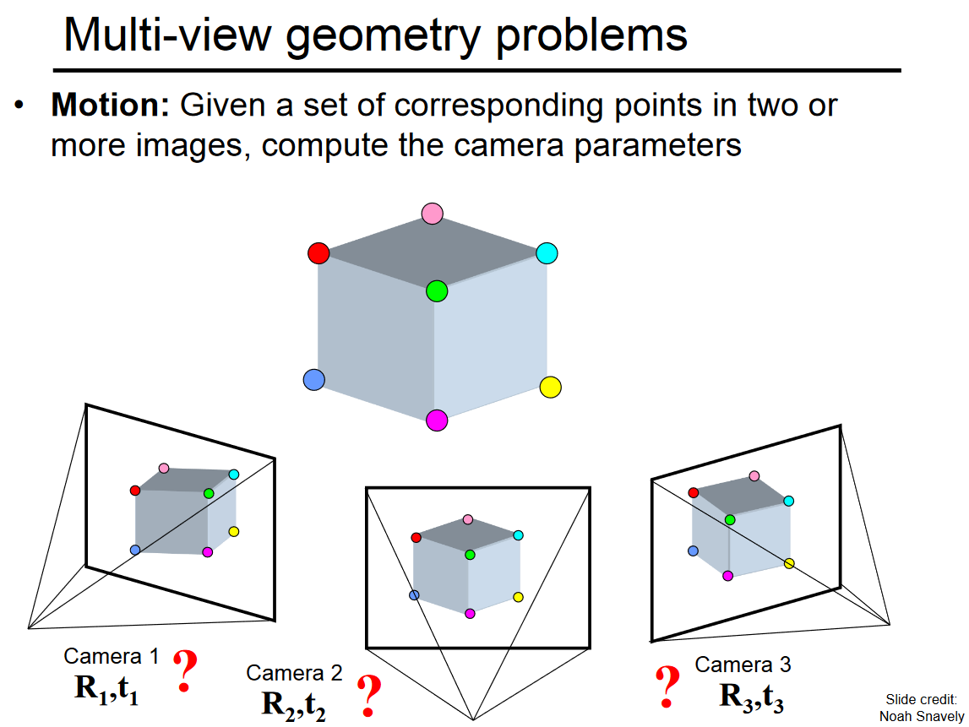
3D point coordinates
are unknown, but we
won’t try to estimate them
Camera frame
transformations
are unknown and to
be estimated

Slide 34
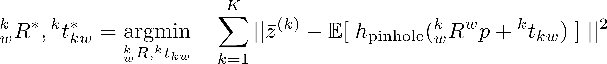
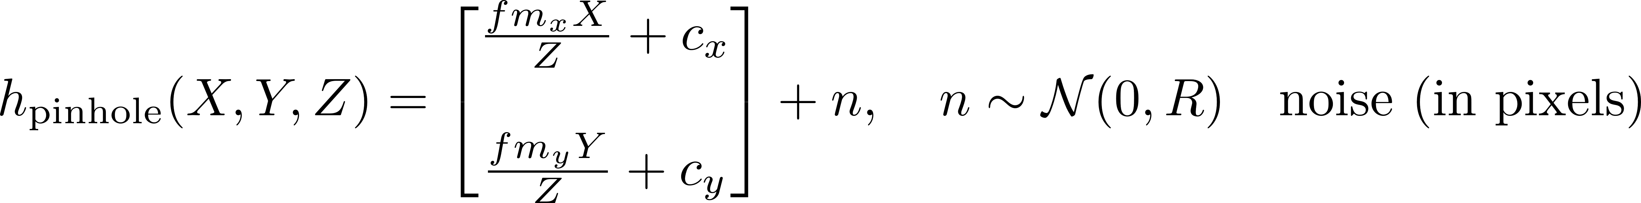
Camera localization as a least squares problem?
The only terms to be
optimized.
But, 3D position is unknown!
So, we cannot solve the problem using the reprojection error until we know the 3D position corresponding to the keypoint.

Slide 35

Let’s restrict the discussion
to two cameras only

Slide 36


Slide 37


Slide 38


Slide 39


After estimating the
essential matrix, we
extract t, R.
However, the
translation t, is only
estimated up to a
multiplicative scale.
- Translation is not
fully observable with a
single camera.
- To make it observable
we need stereo
“5-point algorithm” by
David Nister computes
essential matrix and then
decomposes it into rotation
and translation.

Slide 40

Visual odometry with a single camera: translation is recovered only up to a scale
Scale = relationship between real-world metric distance units and estimated map distance units
Camera placements (1) and (2) generate
the same observation of P. In fact, infinitely
many possible placements of the two
camera frames along their projection rays
could have generated the same measurement.
(1)
(2)

Slide 41

Visual odometry with a single camera: translation is recovered only up to a scale
Scale = relationship between real-world metric distance units and estimated map distance units
Q: Is there a way to obtain true metric distances
only with a single camera?
A: The only way is to have an object of known
metric dimensions in the observed scene. For
example if you know distances AB, BC, CA then
you can recover true translation. This is commonly
referred to as the Perspective-3-Point (P3P), or in
General, the Perspective-n-Point (PnP) problem.

Slide 42
Visual odometry with a single camera: translation is recovered only up to a scale
Scale = relationship between real-world metric distance units and estimated map distance units
Point in 3D
Q: Does scale remain constant throughout the trajectory
of a single camera?
A: No, there is scale drift, which is most apparent
during in-place rotations (i.e. pure rotation, no translation),
because depth estimation for 3D points is unconstrained,
so it is easily misestimated.
Camera at t = 0
Camera at t = 0

Slide 43


Slide 44
Take-home message on pose prediction: given corresponding features, basic math gives us the camera motion.

Slide 45
Robust Feature matching
Pose prediction works with good matches, but errors would actually pull our solution off of "truth"!
This is one of the most important, and difficult aspects of visual navigation
Several tricks allow us to remove false matches

Slide 46
Finding correct matches
Idea #1: Randomized Sampling and Consensus (RANSAC: Fischler and Bolles 1981)
Iterate:
Pick a set of matches at random just large enough to solve for pose
Compute the solution
Apply the solution to all other matches, and find "inliers"
Stop when enough inliers are found
It is very unlikely we'd accidentally find a "wrong" solution that explains other points. Provable under some assumptions.
Idea #2: Use constraints we can build up from mapping:
Tracking over video frames: features should stay close
3D structure of map should be relatively coherent

Slide 47
Now, maintain a map as we move along

Slide 48

Map representation
Keyframes attached to features
Co-visibility tells us which keyframes are related
Spanning tree and Essential graph allow more rapid global solving

Slide 49

Mapping Algorithm
Construct a local BA problem with the cameras and features seen by the keyframes that "see" the current set of features
These are the ones that can change with the new information
BA is allowed to adjust camera R and t as well as 3D point locations.
Error is reprojection

Slide 50
Mapping: Important Questions
How do the number of keyframes affect...
Run-time of the BA algorithm?
Memory required to store the map?
Difficulty in feature matching between current image and keyframes?

Slide 51
Finally, update estimates when we complete large cycles

Slide 52

Loop Closure
Want to avoid redundant keyframes if we cover the same area
Also reduce drift that accumulates if we don’t re-observe previous areas
Here a full-map BA is run on the keyframes based on the new "loop closing" constraint

Slide 53

Indoor Results w/Kinect

Slide 54
So, what's wrong with this picture?
Opponent view of the ORBSLAM paper (with help from Travis)
ORBSLAM works on everything from cellphone cameras to self-driving cars, but it is a bit overly general, so does not exploit robotic sensors or physical constraints
ORBSLAM is not that efficient computationally

Slide 55





Initialization requires translation to generate initial MapPoints
Assumes translation is on a plane
The scale is arbitrary and similar motions can lead to different scales making repeatability difficult
Stereo cameras allow for single frame initialization
Homogeneous coordinates of a point in world frame:
Left and Right Projection into camera frame:
Solve a linear least squares problem to estimate MapPoint location

Slide 56


Use IMU to make initial estimate of transformation and track the gyro and accelerometer bias in the estimated state:
Tight integration of IMU is used to minimize the relative motion error between two frames (S₀ and S₁):

Slide 57

When merging MapPoints model the position as a Gaussian
During g2o graph optimization, proportionally weight the MapPoints with their respective variance.

Slide 58
ORBSLAM Compute
3 threads required, which are not available on always available on low-powered robots
Even if they are, a robot should do many more tasks!
Representing features and visibility in 3D turns out to be costly. Other methods maintain a 2D matched-point representation only.
The number of keyframes, number of features and precise error functions used are not as elegant nor efficient as some other methods
See more recent papers: Romouliotis (project Tango) among others.

Slide 59


Beyond the KF Assumptions
We used the linear forms of motion and measurement (e.g., z=Hx+noise) at several stages to make the equations easier
But, this was not a good thing in general. Real sensors almost all make nonlinear measurements!
E.g., the robots below sense the distance and angle to the landmarks (l) at the edge of the field
To form this equation, need trigonometry
and square root of squares
These are not linear, so are we stuck?

Slide 60


Landmark-based Localization
Landmarks, whose
position
in the world is known.
Each robot measures
its range and bearing
from each landmark
to localize itself.
State of a robot:

Slide 61

Landmark-based Localization
Measurement at time t,
is a variable-sized
vector, depending on the
landmarks that are
visible at time t.
Each measurement is
a 2D vector, containing
range and bearing from
the robot to a landmark.

Slide 62


Estimation Sequence (1)

Slide 63


Estimation Sequence (2)

Slide 64

Comparison to true trajectory

